Slide 1
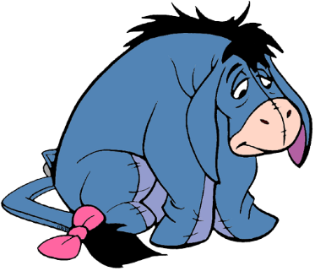
DEPRESSION

Slide 2
TABLE TIME
What movie/scene makes you cry?
What cheers you up when you’re down?
What can you do to brighten someone’s day?

Slide 3
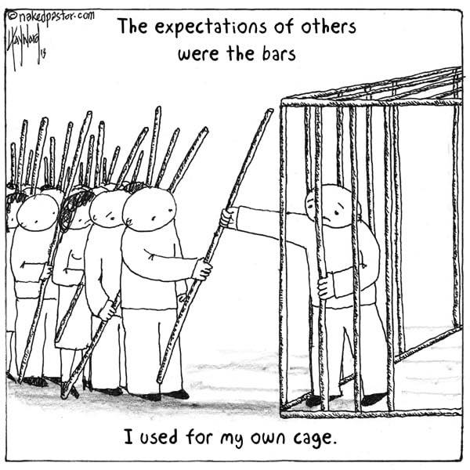
DEPRESSION HAPPENS
A glad heart makes a happy face; a broken heart crushes the spirit.
(Proverbs 15:13)
I am so troubled that I cannot speak.
(Psalm 77:4)
Elijah went a day’s journey into the wilderness. He came to a bush, sat under it and prayed that he might die. “I have had enough, Lord. Take my life; I am no better than my ancestors.” Then he lay down and fell asleep. (1 Kings 19:4)

Slide 4
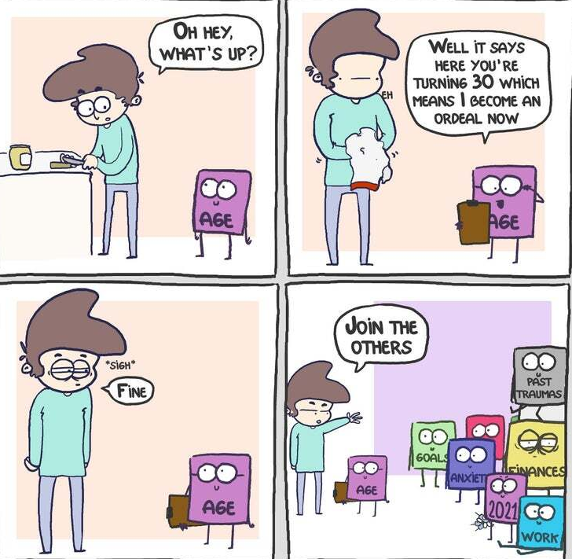
DEPRESSION HAPPENS
Count it all joy, my brothers, when you meet trials of various kinds.
(James 1:2)
In the world you will have tribulation. But take heart; I have overcome the world. (John 16:33)
Count it all joy, my brothers, when you meet trials of various kinds.
(James 1:2)
In the world you will have tribulation. But take heart; I have overcome the world. (John 16:33)
Sorrow is better than laughter, for by sadness of face the heart is made glad. The heart of the wise is in the house of mourning, but the heart of fools is in the house of mirth. (Ecclesiastes 7:3-4)

Slide 5

DEPRESSION SOURCES

Slide 6
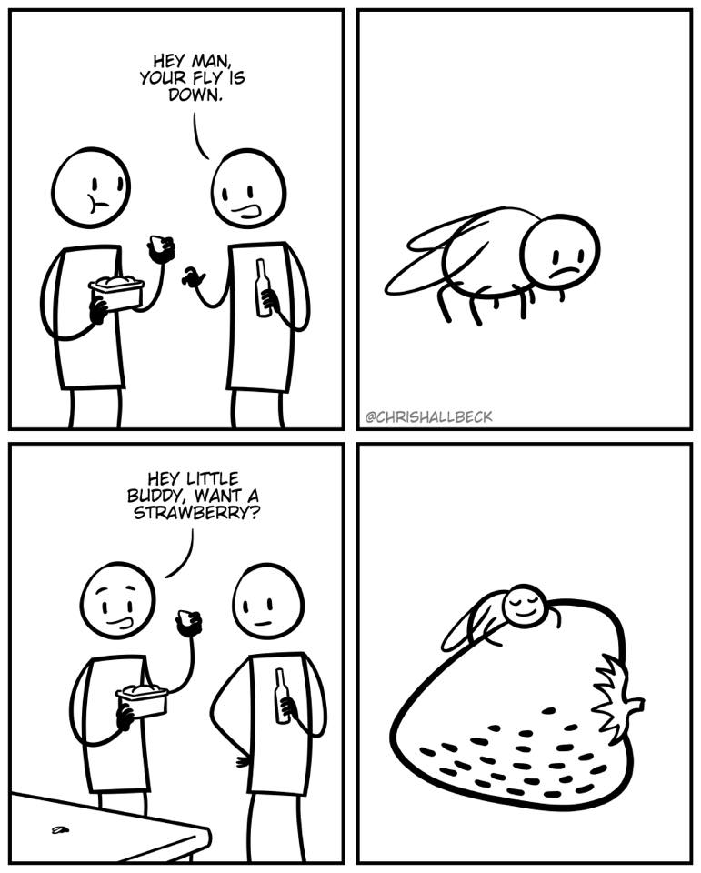
GOD’S PROMISES
The Lord is near to the broken-hearted and saves the crushed in spirit. (Psalm 34:18)
He heals the brokenhearted and binds up their wounds. (Psalm 147:3)
Come to me, all who labor and are heavy laden, and I will give you rest.
(Matthew 11:28)
The Lord is near to the broken-hearted and saves the crushed in spirit. (Psalm 34:18)
He heals the brokenhearted and binds up their wounds. (Psalm 147:3)
Come to me, all who labor and are heavy laden, and I will give you rest.
(Matthew 11:28)
Weeping may tarry for the night, but joy comes with the morning. (Psalm 30:5)
Weeping may tarry for the night, but joy comes with the morning. (Psalm 30:5)

Slide 7
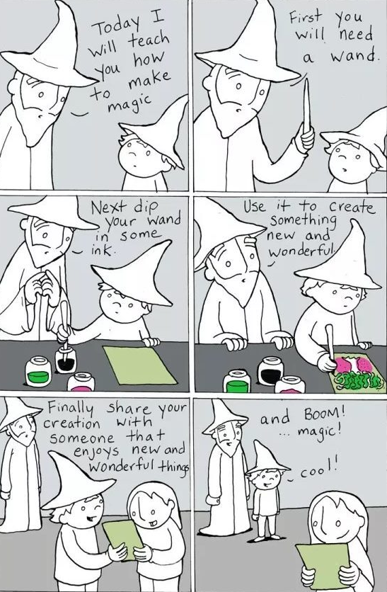
GOD’S PROMISES
Neither death nor life, nor angels nor rulers, nor things present nor things to come, nor powers, nor height nor depth, nor anything else in all creation, will be able to separate us from the love of God in Christ Jesus. (Romans 8:38-39)

Slide 8
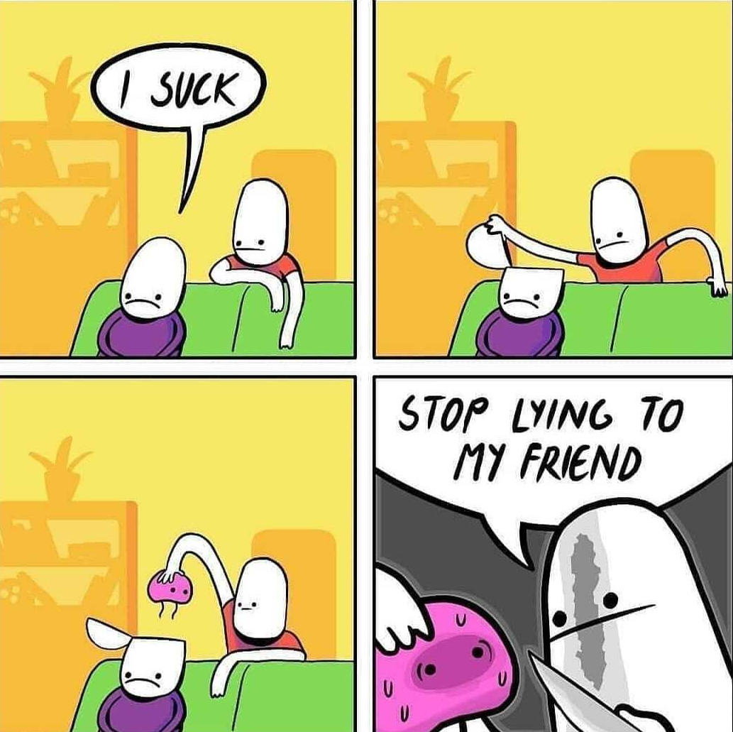
POSITIVE STEPS
Rejoice in the Lord always; again I will say, Rejoice. (Philippians 4:4)
Trust in the Lord with all your heart, and lean not on your own understanding. (Proverbs 3:5)
Finally, brothers, whatever is true, whatever is honorable, whatever is just, whatever is pure, whatever is lovely, whatever is commendable, if there is any excellence, if there is anything worthy of praise, think about these things. (Philippians 4:8)

Slide 9
DEPRESSION RELIEVERS

Slide 10




Slide 11
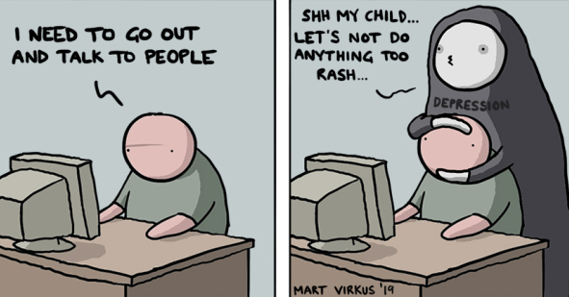
WARNING SIGNS
Talking about hopelessness, worthlessness, being a burden, feeling trapped or having no reason to live
Withdrawing or feeling isolated
No motivation or losing interest in activities
Sudden change in personality or behaviors
Giving away possessions, behaving recklessly
Talking about death or not being here tomorrow
Looking for ways to kill oneself (searches online, buying a gun)

Slide 12
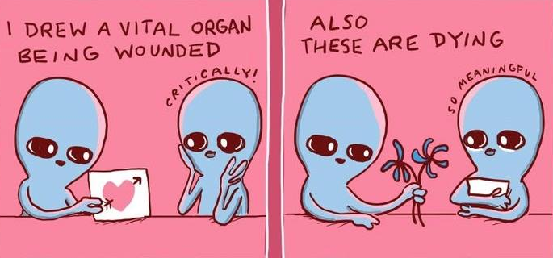
ASK YOURSELF
hydrated?
eaten for 3 hours?
showered today?
stretched your legs today?
said something nice today?
cuddled this week?
therapist this week?
changed medications?
paralyzed by indecision?
daytime: dressed?
nighttime: sleepy but resisting?
feel ineffective?
feel unattractive?
over-exerted – physically, mentally, emotionally, socially?
waited a week?

Slide 13
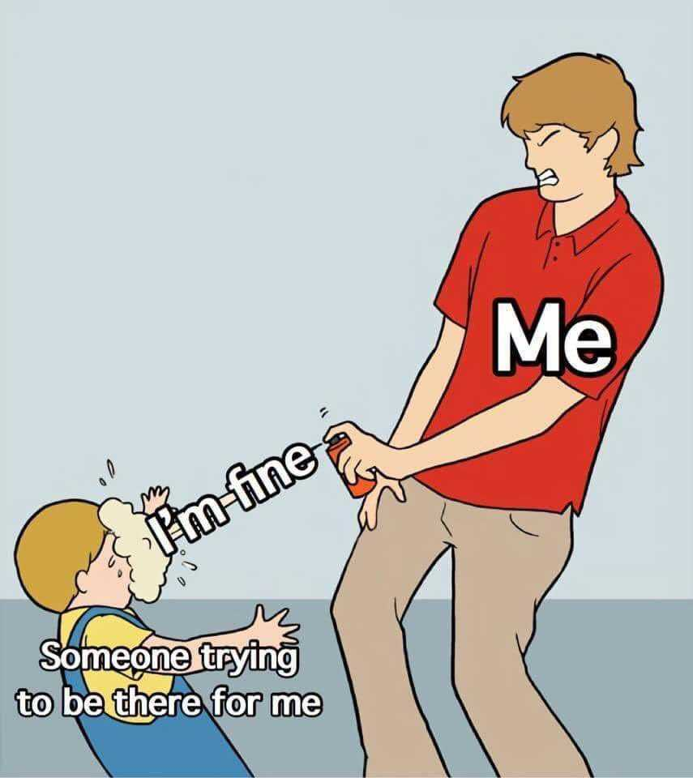
DEPRESSION OUTREACH

Slide 14
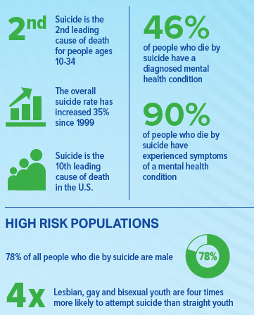
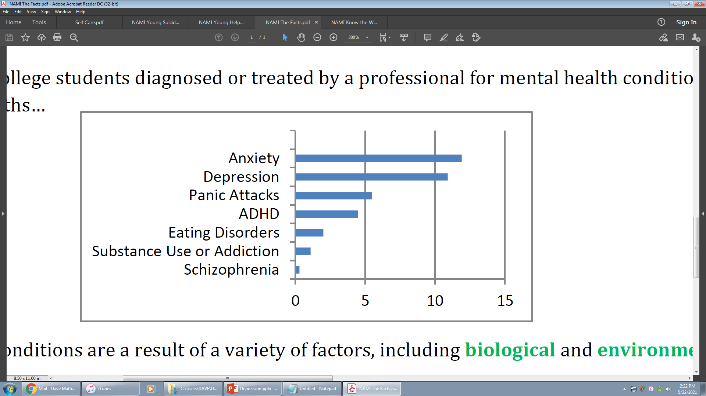

FACTS & FIGURES
7% of students have “seriously considered suicide” in the past year.

Slide 15
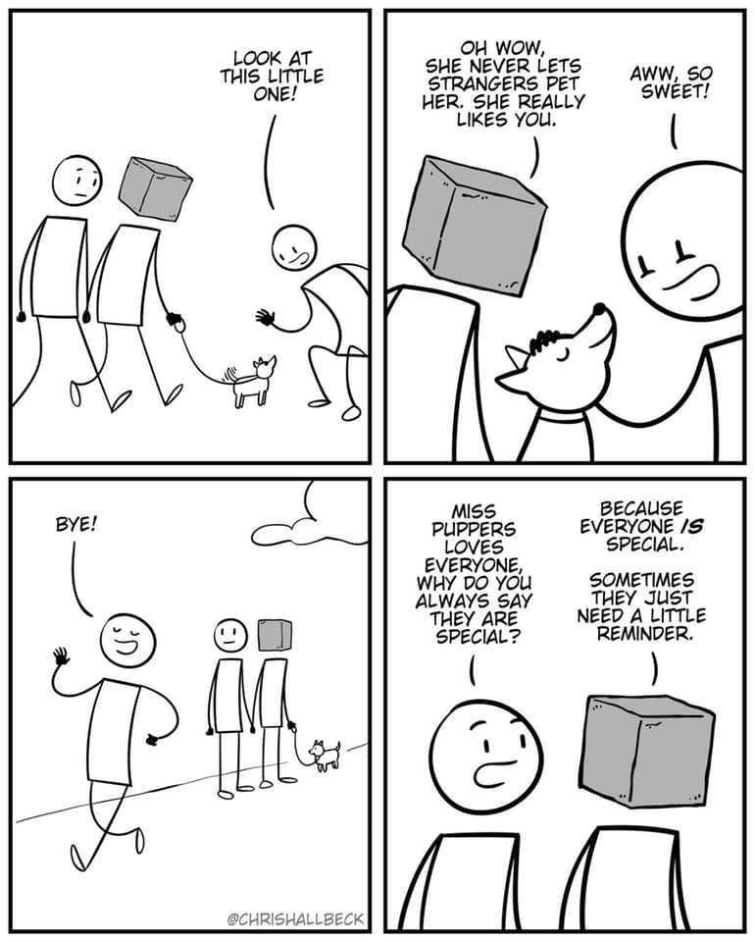
HELP
Share Your Concerns
  “I’ve noticed you ######. Is everything okay?”
Share Your Concerns
  “I’ve noticed you ######. Is everything okay?”
Offer Support (ask, suggest)
  How can I support you now? Is there something I or others can do?
  Can I help you locate mental health services? Can I help you make an appt?
  Can I help you with your errands?
  Would you like me to go with you to a support group? Do you need a ride?
Offer Support (ask, suggest)
  How can I support you now? Is there something I or others can do?
  Can I help you locate mental health services? Can I help you make an appt?
  Can I help you with your errands?
  Would you like me to go with you to a support group? Do you need a ride?
  “I’m worried that you aren’t acting like yourself. Is something up?”
  “It makes me afraid to hear ####. Can we talk to someone?”
Be a Friend
  Check-in regularly
  Include your friend in your plans
  “I’m worried that you aren’t acting like yourself. Is something up?”
  “It makes me afraid to hear ####. Can we talk to someone?”

Slide 16

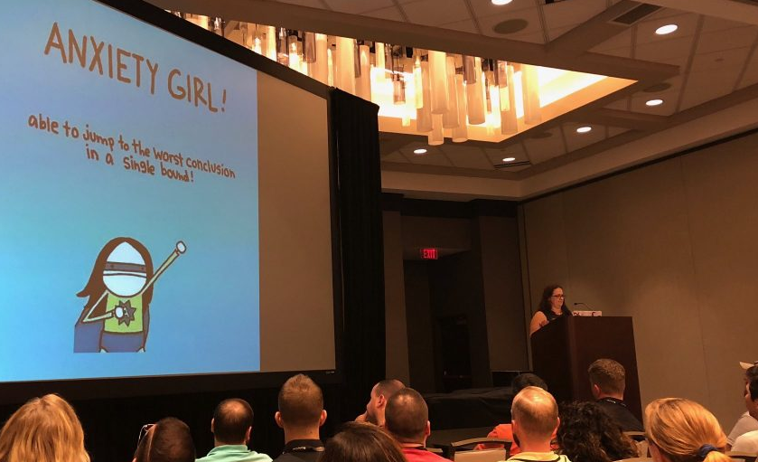

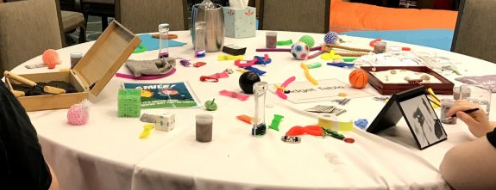
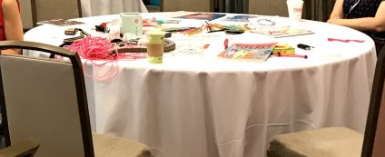
MENTAL HEALTH VILLAGE
MENTAL HEALTH VILLAGE

