Slide 1
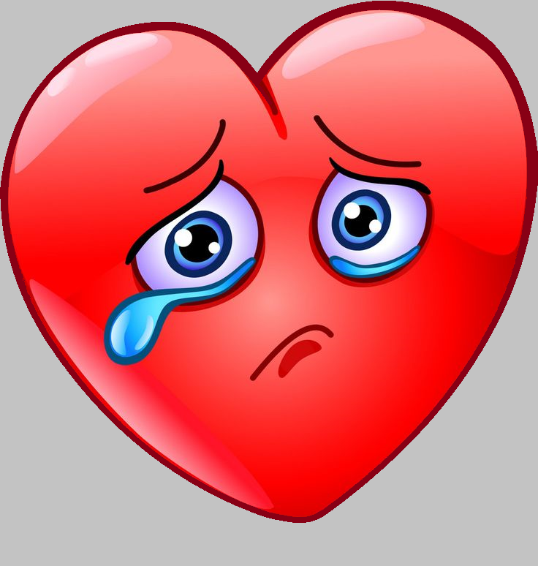
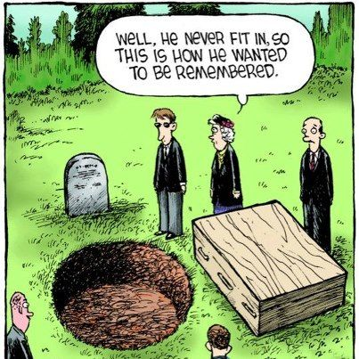
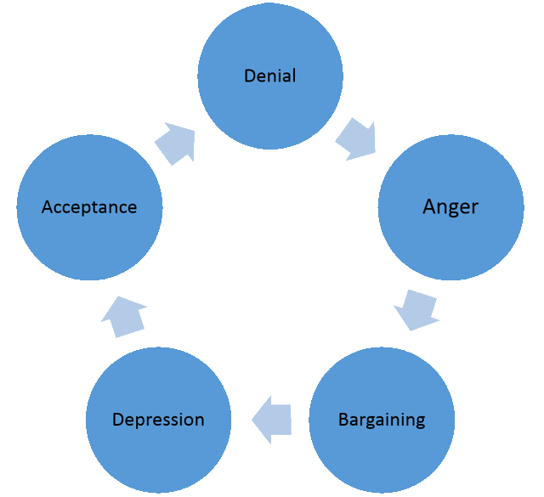
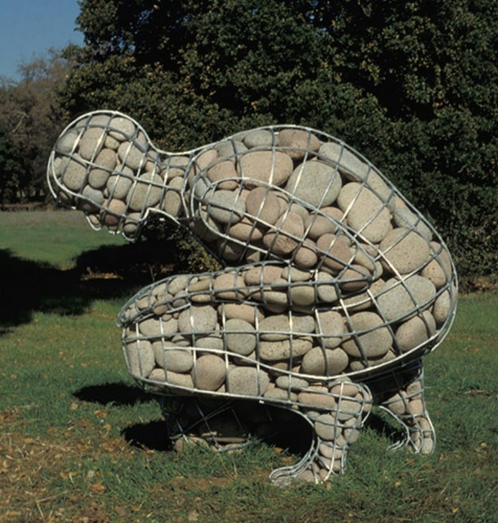
GRIEF

Slide 2
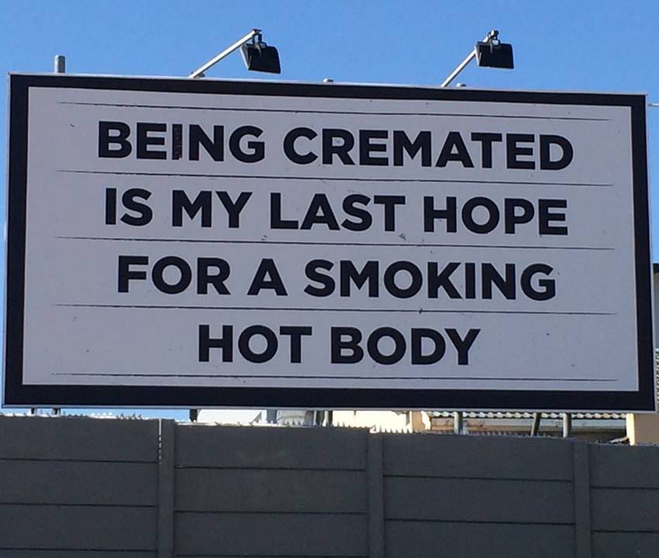
TABLE TIME
How do you plan to be disposed of?
What death has recently impacted you?
What’s your favorite movie death scene?

Slide 3
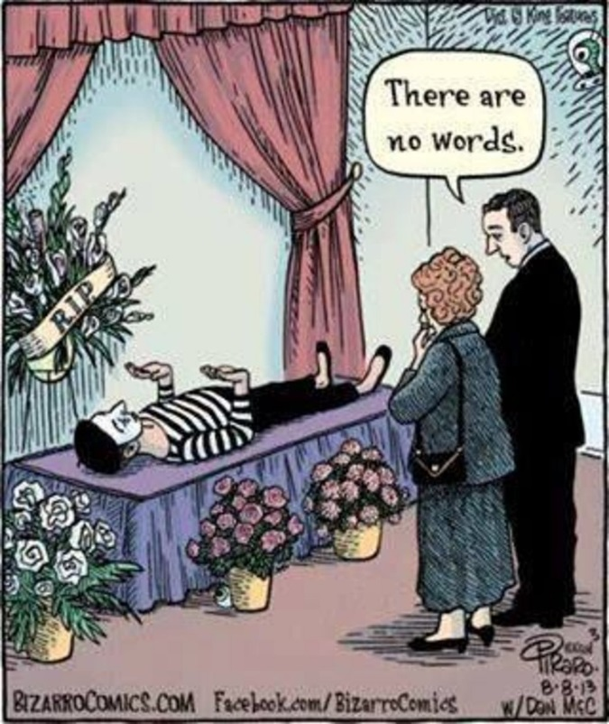
GRIEF IS NATURAL
There is a time for everything,
and a season for every activity
under the heavens:
a time to be born and a time to die,
a time to plant and a time to uproot,
a time to kill and a time to heal,
a time to tear down and a time to build,
a time to weep and a time to laugh,
a time to mourn and a time to dance...
(Ecclesiastes 3:1-4)

Slide 4
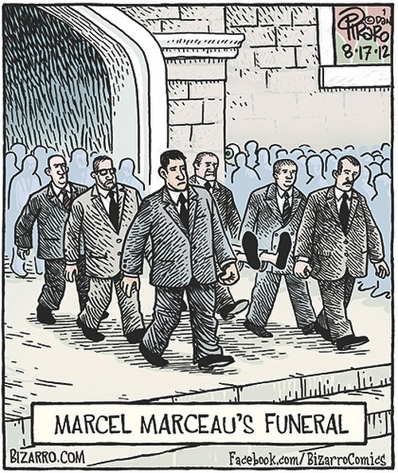
CHRIST UNDERSTANDS
He was despised and rejected – a man of sorrows, acquainted with deepest grief. We turned our backs on him and looked the other way. He was despised, and we did not care. Surely he has borne our griefs and carried our sorrows; yet we
esteemed him stricken, smitten by God, and afflicted.
(Isaiah 53:3-4)
When Jesus saw her weeping, and those who had come with her also weeping, he was deeply moved in spirit and troubled.
(John 11:33)

Slide 5
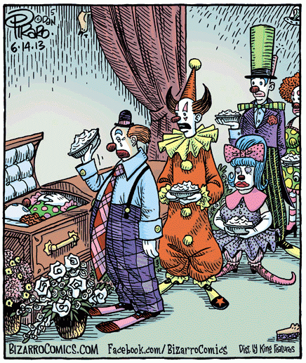
HEALING AND RELIEF
He heals the broken in heart, and binds up their wounds.
(Psalm 147:3)
Blessed are those who mourn, for they shall be comforted.
(Matthew 5:4)
Come to me, all you that labor and are heavy laden, and I will give you rest.
(Matthew 11:28)

Slide 6
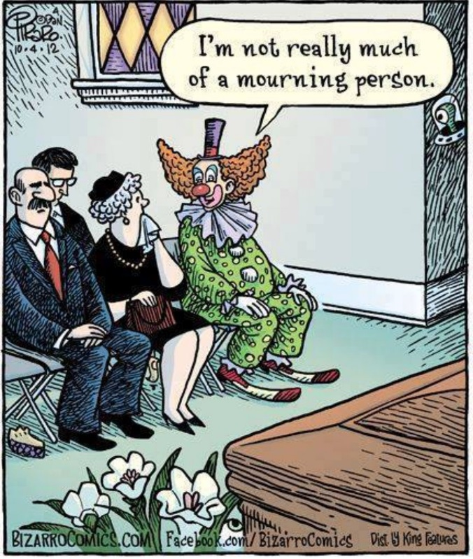
DEATH HAS LOST
For I consider that the sufferings of this present time are not worth comparing with the glory that is to be revealed to us.
(Romans 8:18)
I have fought the good fight, I have finished the race, I have kept the faith. Now there is in store for me the crown of righteousness, which the Lord, the righteous Judge, will award to me on that day – and not only to me, but also to all who have longed for his appearing.
(2 Timothy 4:7-8)

Slide 7
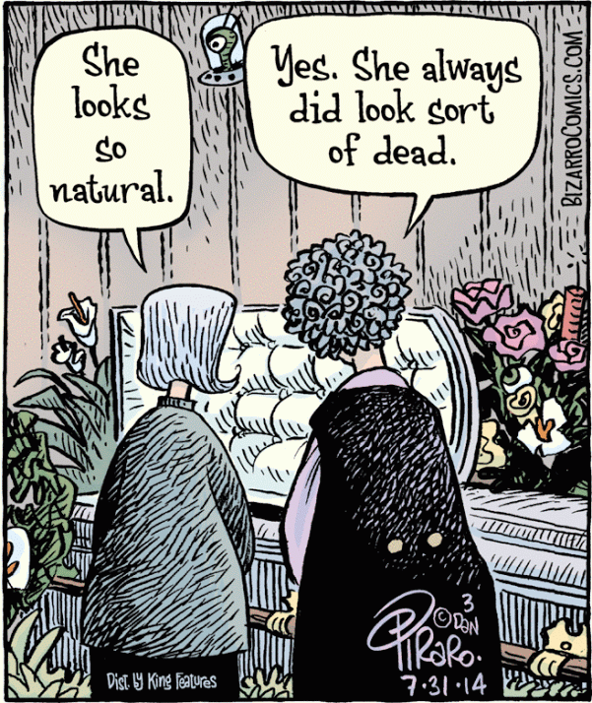
NO PAIN, NO GAIN
We also glory in our sufferings, because we know that suffering produces perseverance; perseverance, character; and character, hope.
(Romans 5:3-5)
Praise be to the Father of compassion and the God of all comfort, who comforts us in all our troubles, so that we can comfort those in any trouble with the comfort we ourselves receive from God.
(2 Corinthians 1:3-4)

Slide 8
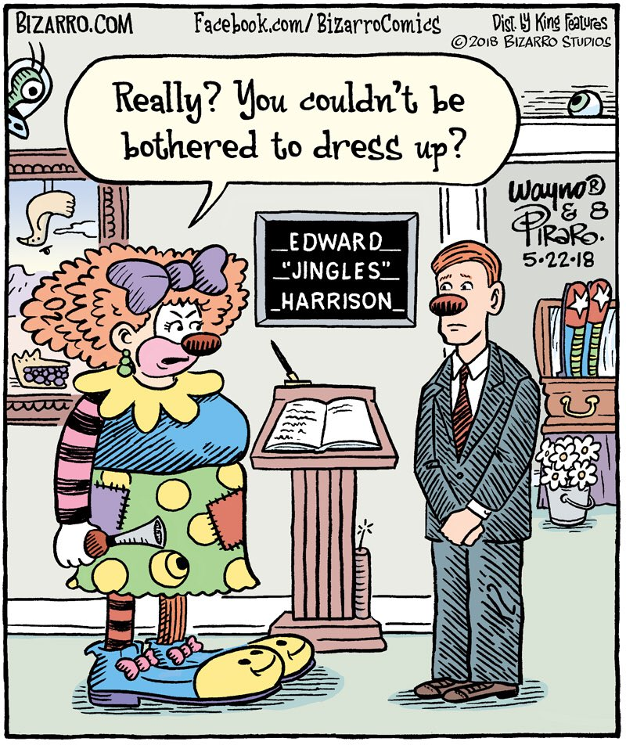
PEACE
Even though I walk through the valley of the shadow of death, I will fear no evil, for you are with me; your rod and your staff, they comfort me.
(Psalm 23:4)
Peace I leave with you; my peace I give to you. Not as the world gives do I give to you. Let not your hearts be troubled, neither let them be afraid.
(John 14:27)

Slide 9
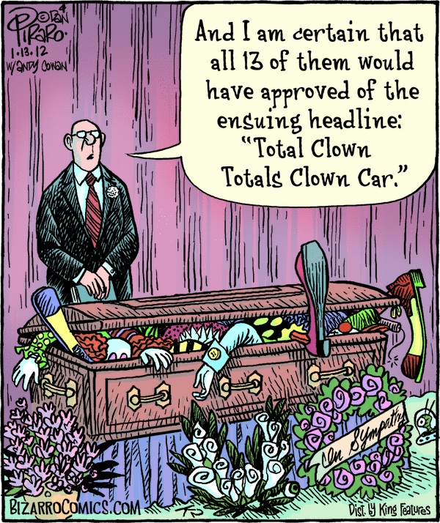
NO SORROW
Worldly sorrow, which lacks repentance, results in spiritual death. For godly grief produces a repentance that leads to salvation without regret, whereas worldly grief produces death.
(2 Corinthians 7:10)
And God shall wipe away all tears from their eyes; and there shall be no more death, neither sorrow, nor crying, neither shall there be any more pain: for the former things are passed away.
(Revelation 21:4)

Slide 10
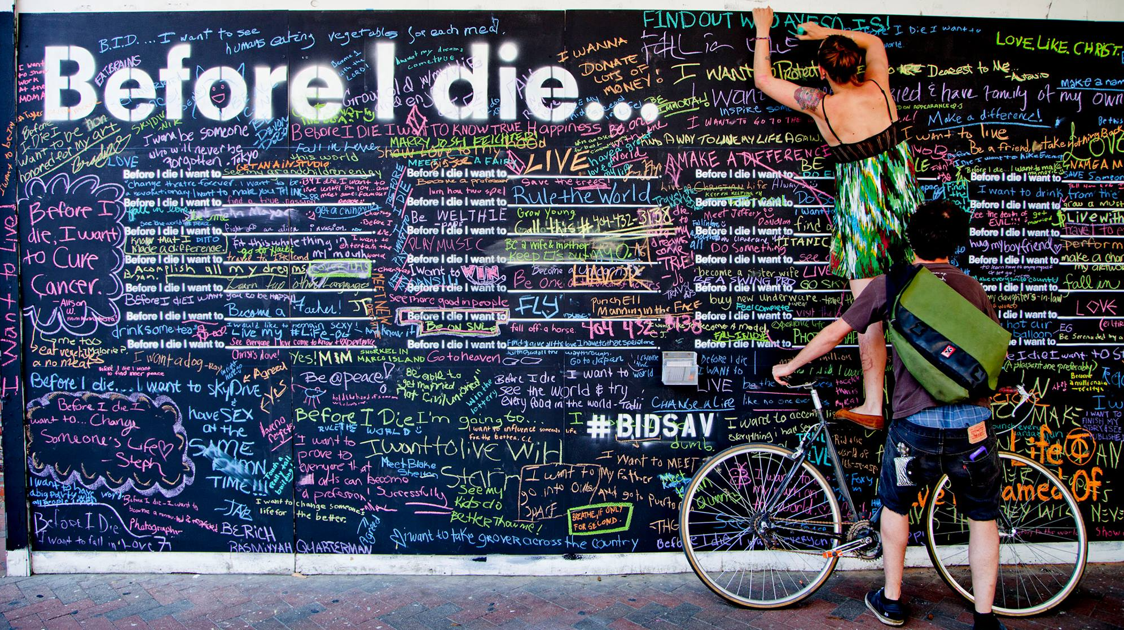
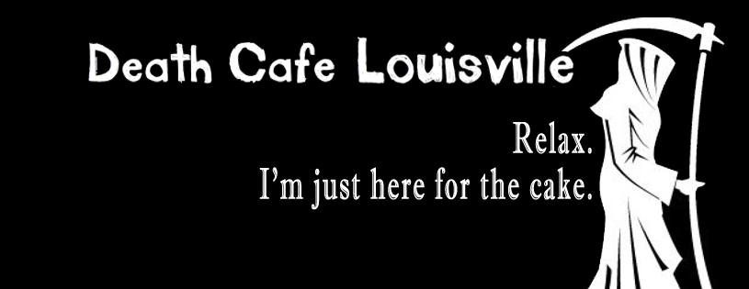

Slide 11
